Slide 1

Week 05
Capsule – B: Management & Leadership

Slide 2
Unit # 5:
Creating a Consumer Focus

Slide 3
Ethics

Slide 4
What is Ethics?
Ethics comes from the Greek word, ethos, which means moral character
Ethics means knowing the difference between right and wrong and continuing to do the right thing
Ethical business decisions can be based on your conscience or based on principle.
In a business sense, corporate leaders must follow the right behavior to benefit the good of everyone including the shareholders, stakeholders, employees, customers, and the community

Slide 5
Social Responsibility

Slide 6
What is Social Responsibility?
Social responsibility is an ethical theory in which individuals are accountable for fulfilling their civic duty, and the actions of an individual must benefit the whole of society
OR
Working for the community, supporting issues that affect society, such as advocating political or social issues that can help others—for example,
Advocating for child labor laws
Purchasing fair trade products
Recycling
Volunteering
Giving blood donations
Working at a food bank or animal shelter

Slide 7
Categories of Social Responsibility
Social responsibility is traditionally broken into four categories
Environmental Responsibility
Ethical Responsibility
Philanthropic Responsibility
Economic Responsibility

Slide 8
Social Obligation & Social Responsibility
Social obligation is when a firm engages in social actions because of it’s obligations to meet certain economic and legal responsibilities.
The organization does what it is obligated to do and nothing.
This concept give rise to the classical view of the social responsibility which says that management is only responsible for “profit maximization”
Manager’s primary responsibility is to operate the business in the best interests of the stockholders, whose primary concern are financial.
When the organizations decide to spend the organizations resources for social good they add to the costs of doing business, which have to be passed on to the consumers through higher prices or absorbed by stockholders / shareholders through smaller dividends

Slide 9
Social Responsiveness & Social Responsibility
This Socio Economic View states that the manager’s responsibility go beyond making profits to include protecting and improving society’s welfare.
Social responsiveness is when a company engages in social actions in response to some popular social need.
Example;
Ford motor company became the first company to endorse a federal ban on sending text messages while driving.
In 2010, during the disastrous floods, many companies responded to the immense needs in the effected regions, like the NGOs who have company wide policy that urges employees to volunteer during natural disasters and other crisis.
This concept defines social responsibility as a business intention beyond it’s legal and economic obligations, to do right things and act in the way that are good for the society

Slide 10
Should Organizations be Socially Involved?
For |  | Against
Public Expectations |  | Violation of Profit maximization
Long-run Profits |  | Dilution of Purpose
Ethical Obligations |  | Costs
Public Image |  | Too Much Power
Better Environment |  | Lack of Skills
Discouragement of further governmental regulation |  | Lack of Accountability
Balance of responsibility and power
Stock Holder Interests
Possession of resources
Superiority of prevention over cure

Slide 11
Green Management

Slide 12
Green Management and Sustainability
Green Management:
Managers consider the impact of their organization on the natural environment i.e. do things to protect and preserve the environment
Some do it merely as it is required by the law i.e. by radically changing their products and production processes
Some do more than what is required by the law
Example;
Companies using renewable energy sources, preserving forests and conserving water
Carpet making industries using recyclable plastic containers to produce fiber for making carpets
Google and Intel initiated an effort to get computer makers and customers to adopt to technologies that reduce energy consumption.

Slide 13
Green Management and Sustainability
Green Approaches
Low
Environmental Sensitivity
High
Legal Approach
Market Approach
Stakeholder Approach
Activist Approach
Light Green
Dark Green
It means simply doing what is required by the law / legally.
These organizations exhibit little environmental sensitivity
Organizations here respond to the environmental preferences of customers
Example:
Usage of less hazardous and less pollutant chemicals
Organizations work to meet the environmental demands of multiple stakeholders such as employees, suppliers or community
Organizations work in ways to protect the earth’s natural resources.
Example:
Belgian company “ECOVER” produces ecological cleaning products in a near zero emission factory, has a grass roof (keeping things cool in summer and warm in winters) & a water treatment system that runs on wind and solar energy

Slide 14
Evaluating Green Management Actions
As the company become “greener” they often release detailed reports on their environmental performance.
More than 1300 companies around the globe voluntarily report their efforts in promoting environmental sustainability using the guidelines developed by Global Reporting Initiative (GRI)
Another way is that organizations pursue standards developed by the non-governmental International Organization for Standardization (ISO)
ISO 9000 – Quality Management
ISO 14000 – Environmental Management
One final way to evaluate company’s green actions is to use the Global 100 list of the most sustainable organizations in the world, this list is announced each year at the World Economic Forum.

Slide 15
Managers and Ethical Behaviour
Managers face ethical issues at all levels, areas, sizes and kinds of organizations.
Is it ethical for a sales agent to bribe a purchasing agent as an inducement to buy?
Is it ethical for someone to use a company car, phone, email, for private use?
As managers plan, organize, lead and control, they must consider ethical dimensions. Many decisions that managers make require the consideration of both the process and who gets affected by the result.
The factors that determine ethical behaviour are:
stage of moral development
individual characteristics
organization’s structural design
organization’s culture
intensity of ethical issues

Slide 16
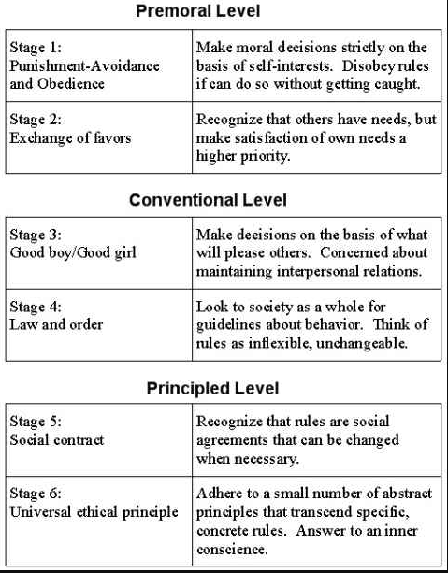
Ethical Behaviour Factors
Stage of moral development
preconventional level (1): a person’s choice between right or wrong is based on personal consequences from outside sources (e.g. physical punishment, reward, etc.)
conventional level (2): ethical decisions rely on maintaining expected standards and living upto the expectations of others.
Principled level (3): individuals define moral values apart from the authority of the groups in which they belong or society in general.

Slide 17
Ethical Behaviour Factors
Individual Characteristics:
values: each person has a relatively entrenched set of personal values, which represent basic convictions about what is right and what is wrong. Develop at a young age based on what is seen or heard from parents, teachers, friends and others. This means that employees in the same organization possess different values.
personality: Two personality variables have been found to influence an individual’s actions according to his or her beliefs about what is right or wrong:
ego strength: measures the strength of a person’s convictions.
locus of control: degree to which people believe they control their own fate.
internal: believe they control their own destinies, therefore take responsibility for consequences and rely on internal standards of right and wrong to guide behaviour
external: what happens to them is due to luck or chance, therefore less likely to take responsibility for consequences of their behaviour and rely on external forces.

Slide 18
Ethical Behaviour Factors
Structural variables:
organizational structures that minimize ambiguity and uncertainty with formal rules and regulations, and those that continuously remind employees of what is ethical are more likely to encourage ethical behaviour.
Use of goals to guide and motivate can backfire, as employees who don’t reach goals are more likely to engage in unethical behaviour, with or without the benefit of economic incentives to do so.
Performance appraisal system design also has an influence, depending on the focus; is it exclusively on outcomes or both ‘means and ends’. Evaluation based on only outcomes will result in the pressure to look good on the outcomes and not ‘how’ the results were achieved.
Reward allocation, the more these depend on specific goal outcomes, the more employees are pressured to do whatever they must to reach those goals. This can lead to the compromise of ethical standards.

Slide 19
Ethical Behaviour Factors
Organizational culture:
The content and strength of an organization’s culture also influence ethical behaviour.
Values reflect what the organization stands for and what it believes in, creates an environment that influences employee behaviour ethically or unethically.
Value based Management, is when an organization’s values guide employees in the way they do their jobs.
Culture that promotes high ethical standards: high in risk tolerance, control and conflict tolerance.
Employees in such culture are encouraged to be aggressive and innovative.
Employees have awareness that unethical practices will be discovered
Employees are free to openly challenge expectations that are considered unrealistic or personally undesirable.
Examples; Timberland ‘Make it Better’, Corning ‘integrity’
Managers play an important role in influencing and shaping culture of ethical practices.
A strong culture exerts more influence on employees than a weak one (guidelines and penalties).

Slide 20
Ethical Behaviour Factors
Issue Intensity: The intensity of the ethical issue itself determines the influence on ethical behaviour.
Six characteristics determine issue intensity or how important an ethical issue is to an individual:
greatness of harm
consensus of wrong
probability of harm
immediacy of consequences
proximity to victims
concentration of effect
These factors suggest that the larger the number of people harmed, the more agreement that the action is wrong, the greater the likelihood that the action will cause harm, and more immediately that the consequences of the actions would be felt, the closer the person feels to the victims, and the more concentrated the effort of the action on the victims, the greater the issue intensity or importance .

Slide 21
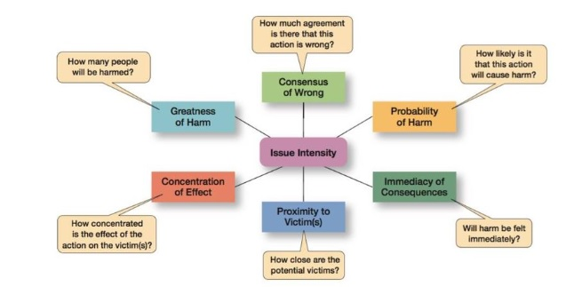

Slide 22
Ethical Behaviour Factors
These factors suggest that:
the larger the number of people harmed,
the more agreement that the action is wrong,
the greater the likelihood that the action will cause harm,
and more immediately that the consequences of the actions would be felt,
the closer the person feels to the victims,
and the more concentrated the effort of the action on the victims,
the greater the issue intensity or importance .

